Slide 1
Technical task
Project 1
Desktop chat

Slide 2
I would like to see …
Registration and authorization
Chat page
Chat setup
Ability to listen to music and video

Slide 3
Technology
Swing
JDBC
Maven
Spring security
PostgreSQL
Git

Slide 4
Swing
Swing - a library that contains the necessary set of components for creating a graphical user interface. With Swing, you can write a desktop application in Java.

Slide 5
JDBC
JDBC (англ. Java DataBase Connectivity - соединение с базами данных на Java) - platform independent industry standard for interaction of Java applications with various DBMS.

Slide 6
Apache Maven
Apache Maven — a framework for automating the assembly of projects based on the description of their structure in files in the POM (Project Object Model) language, which is a subset of XML.

Slide 7
Spring Security
Spring Security - a framework that focuses on providing both authentication and authorization in Java applications. Like all Spring projects, its real strength lies in the fact that it can be easily extended with the necessary functionality.

Slide 8
PostgreSQL
PostgreSQL - free object-relational database management system (DBMS).

Slide 9
Git
Distributed version control system.

Slide 10
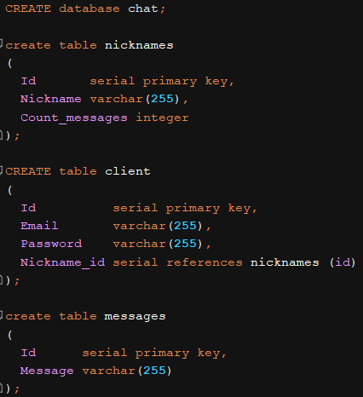
Таблицы в базе данных

Slide 11
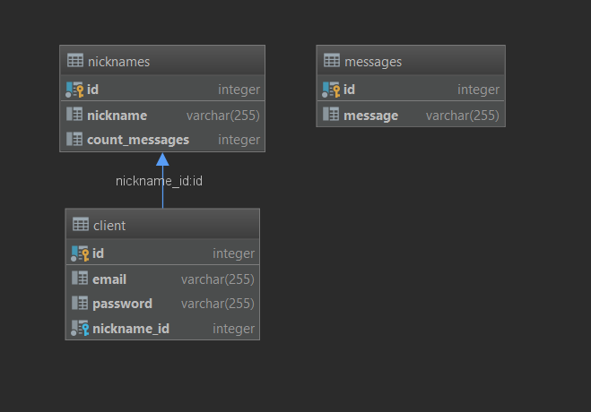
Database links

Slide 12
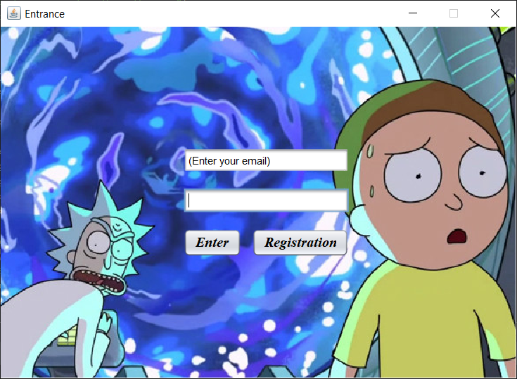
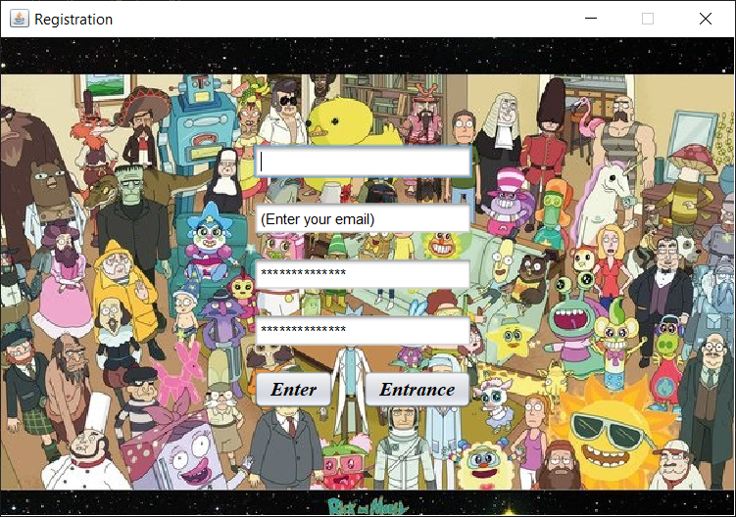
Authorization and registration

Slide 13
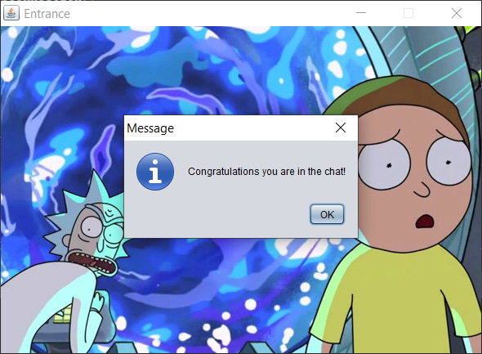
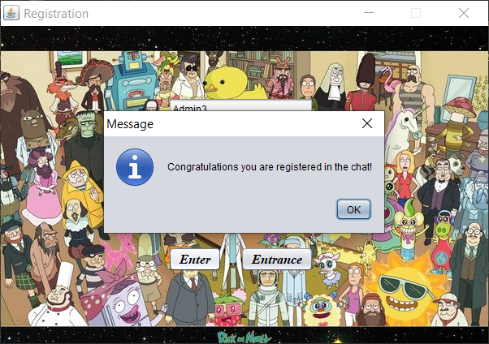
Messages

Slide 14
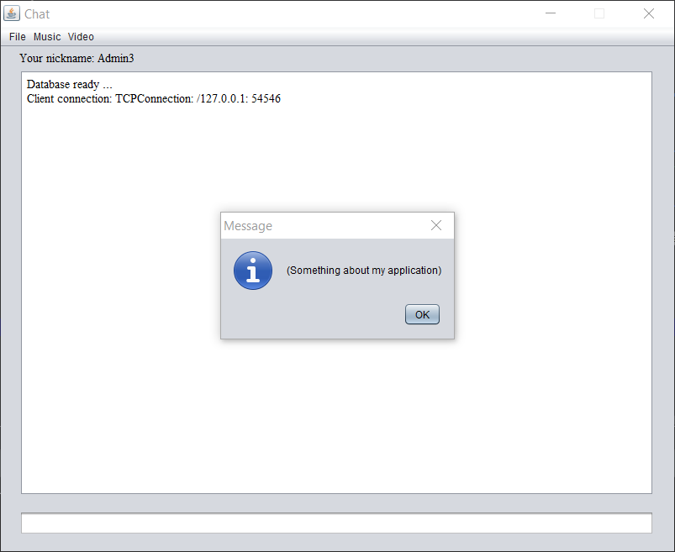
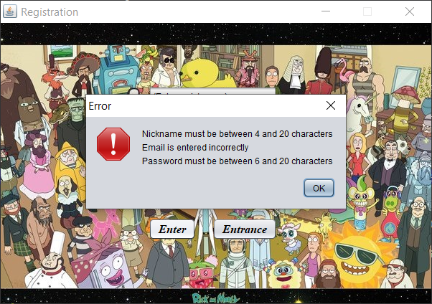
Messages

Slide 15
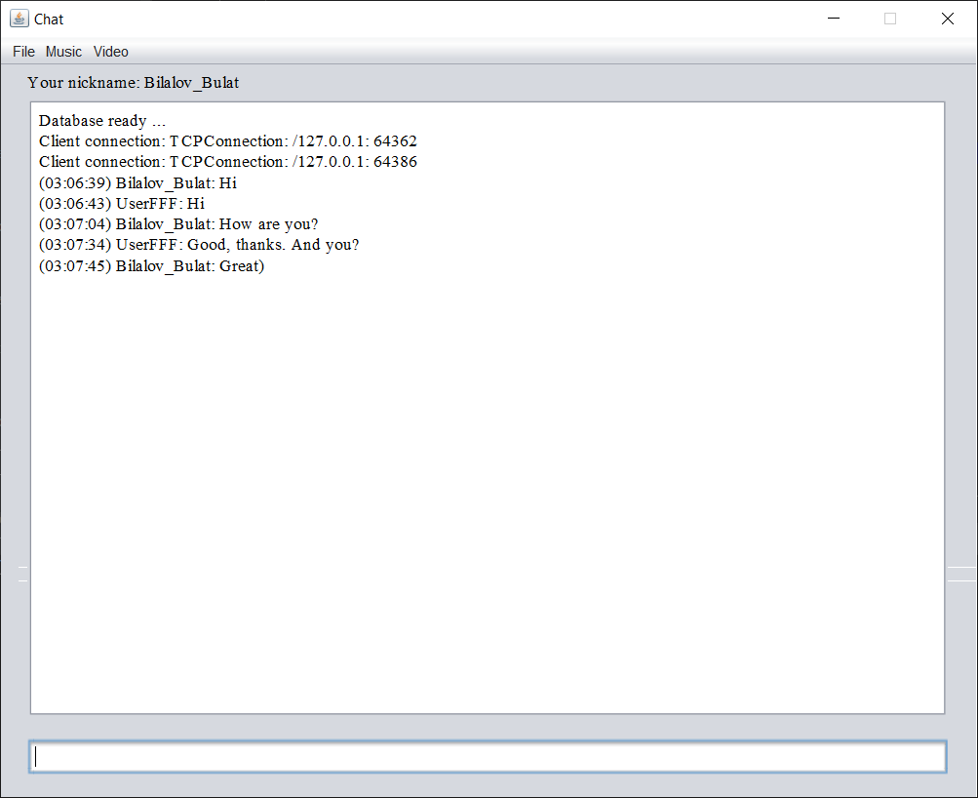
Chat

Slide 16
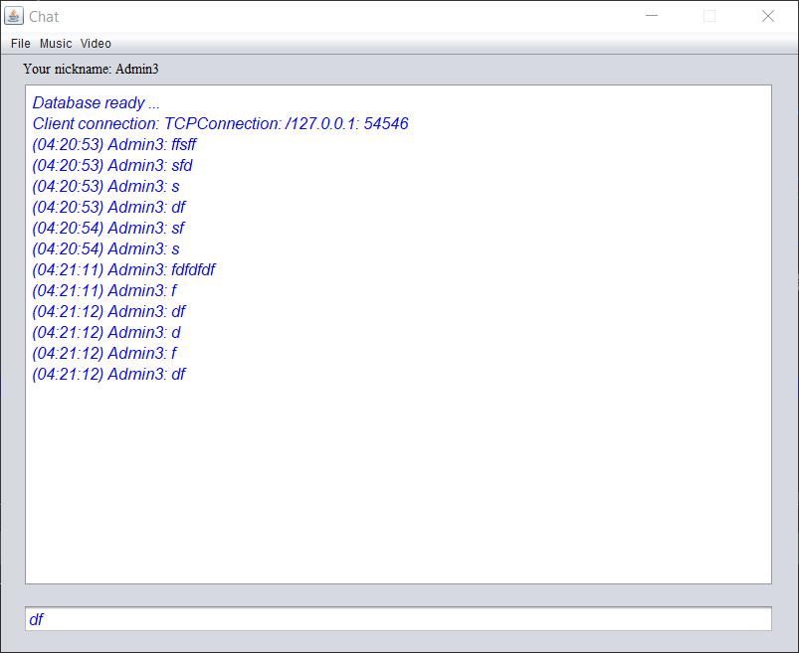
Design change

Slide 17
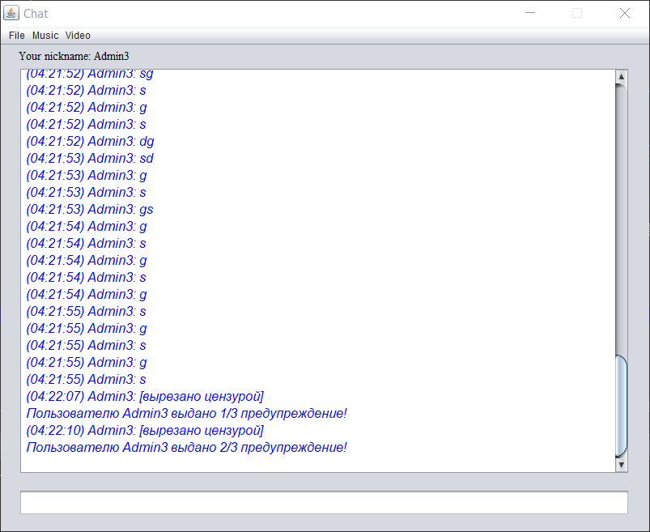
Censorship

Slide 18
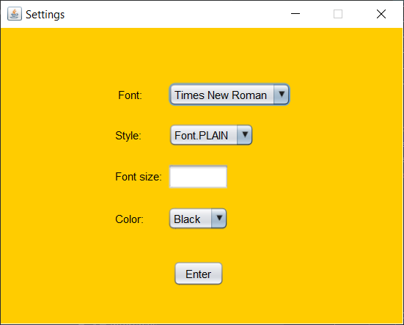
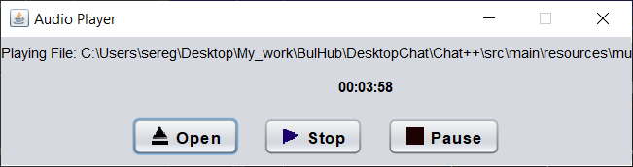
Music settings and listening

Slide 19
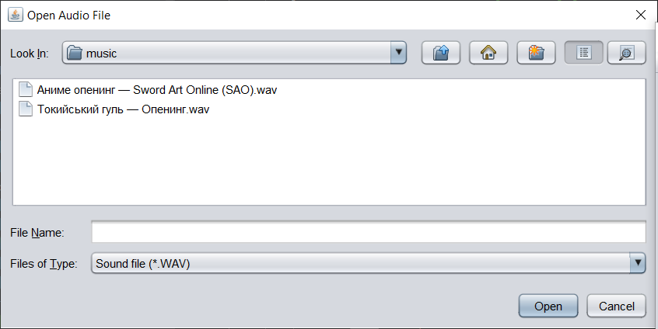
Music selection

Slide 20
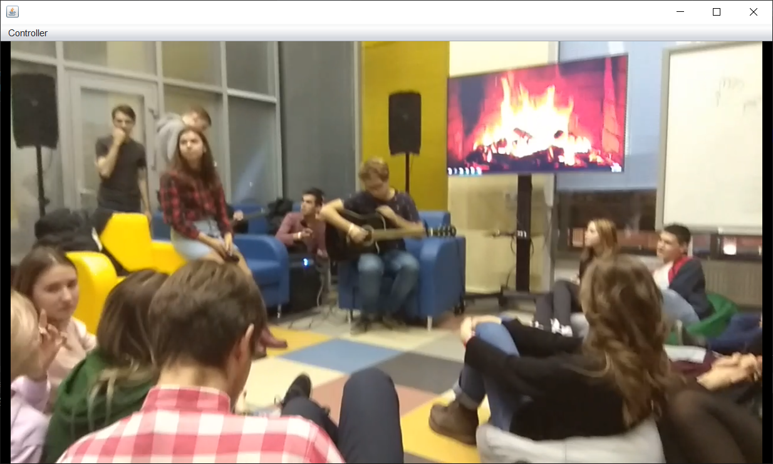
Watching video

Slide 21
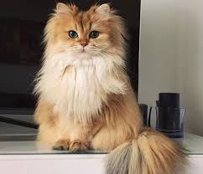
Thanks for your attention!

